Slide 1
Instructor Materials Chapter 4: Overview of Preventive Maintenance
IT Essentials v6.0
Notes:
Cisco Networking Academy Program
IT Essentials
Chapter 4: Overview of Preventive Maintenance

Slide 2
Instructor Materials - Chapter 4 Planning Guide
This PowerPoint is divided in two parts:
Instructor Planning Guide
Information to help you become familiar with the chapter
Teaching aids
Instructor Class Presentation
Optional slides that you can use in the classroom
Begins on slide #10
Note: Remove the Planning Guide from this presentation before sharing with anyone.
Notes:
2

Slide 3
ITE 6.0 Planning Guide
Chapter 3: Computer Assembly
Notes:
ITE 6.0 Planning Guide
Chapter 4: Overview of Preventive Maintenance

Slide 4
Chapter 4: Activities
What activities are associated with this chapter?
Page Number | Activity Type | Activity Name
4.2.1.3 | Interactive Activity | Identify the Problem
Notes:
4

Slide 5
Chapter 4: Assessment
Students should complete Chapter 4, “Assessment” after completing Chapter 4.
Quizzes, labs, Packet Tracers and other activities can be used to informally assess student progress.
Notes:
5

Slide 6
Chapter 4: Best Practices
Prior to teaching Chapter 4, the instructor should:
Complete Chapter 4, “Assessment.”
The goal of this chapter is to explain the basics of preventive maintenance and troubleshooting.
Ensure that students understand that, just like any machine, computers require periodic maintenance.
Stress the fact that operating systems create and remove a number of files during normal computer operation and the maintenance required to keep the OS performing properly.
Make sure students understand that while electronic components experience less wear than mechanical components, all components will eventually fail due to normal operation.
Students may be discouraged by the troubleshooting process at first; make sure they understand it must be practiced and that it will take some time before they become experts.
Notes:
6

Slide 7
Chapter 4: Additional Help
For additional help with teaching strategies, including lesson plans, analogies for difficult concepts, and discussion topics, visit the ITE Community at community.netacad.net.
If you have lesson plans or resources that you would like to share, upload them to the ITE Community in order to help other instructors.
Notes:
7

Slide 8
Chapter 4: Topics in chapter that are not found in the CompTIA A+ 220-901 Certification
This slide lists content included in this chapter that is NOT listed in the CompTIA A+ 220-901 blueprint. Instructors could skip these sections; however, they should provide additional information and fundamental concepts to assist the student with the topic.
All content in Chapter 4 is aligned to the certification.
Notes:
8

Slide 9


Slide 10
Chapter 4: Overview of Preventive Maintenance
IT Essentials v6.0
Notes:
Cisco Networking Academy Program
IT Essentials
Chapter 4: Overview of Preventive Maintenance

Slide 11
Chapter 4 - Sections & Objectives
4.1 Preventive Maintenance
Explain why preventive maintenance must be performed on personal computers.
4.2 Troubleshooting Process
Explain how to troubleshoot computer problems.
4.3 Chapter Summary
Notes:
11

Slide 12
4.1 Preventive Maintenance
Notes:
Cisco Networking Academy Program
IT Essentials
Chapter 4: Overview of Preventive Maintenance

Slide 13
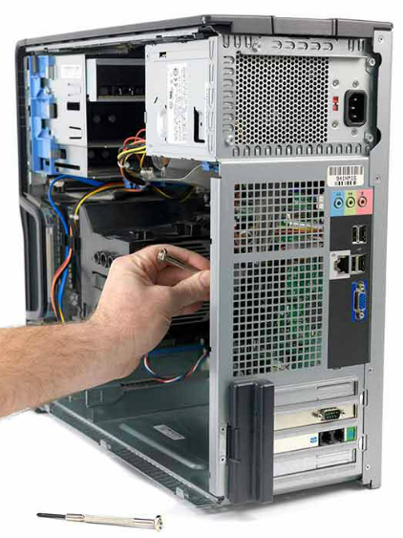
Preventive Maintenance PC Preventive Maintenance Overview
Benefits of Preventive Maintenance
Reduces potential hardware and software problems, computer downtime and repair costs by:
Improving data protection
Extending the life of the components
Improving equipment stability
Preventive Maintenance Tasks
Hardware tasks include:
remove dust from fans, power supply, internal components and peripherals, clean the mouse, keyboard, and display, check for and secure any loose cables.
Software tasks include:
review and install appropriate OS, security and driver updates, regularly update virus definition files, regularly scan for virus and spyware, remove unwanted programs, regularly scan hard drive for errors.
Notes:
4.1 – Preventive Maintenance
4.1.1 – PC Preventive Maintenance Overview

Slide 14
Preventive Maintenance PC Preventive Maintenance Overview (Cont.)
Clean the Case and Internal Components
Dust or dirt can accumulate inside the computer.
Accumulated dirt and dust block airflow inside the case.
Use a low-air-flow ESD vacuum cleaner
Make sure to keep the following internal components clean: Heat sink and fan assembly, RAM, adapter cards, motherboard, fans, power supply and internal drives.
Inspect Internal Components
Examine the computer on a regular schedule.
The main components to inspect are: CPU heat sink and fan assembly, RAM, storage devices, adapter cards, screws, cables, power devices, keyboard and mouse.
Notes:
4.1 – Preventive Maintenance
4.1.1 – PC Preventive Maintenance Overview (Cont.)

Slide 15
Preventive Maintenance PC Preventive Maintenance Overview (Cont.)
Environmental Concerns
Computers should not be operated in harsh environmental conditions.
Due to their mobile nature, laptops are subject to various environmental conditions.
Guidelines to help ensure optimal computer operating performance include:
Do not obstruct vents or airflow to the internal components.
Keep the room temperature between 45 to 90 degrees Fahrenheit (7 to 32 degrees Celsius).
Keep the humidity level between 10 and 80 percent.
Notes:
4.1 – Preventive Maintenance
4.1.1 – PC Preventive Maintenance Overview (Cont.)

Slide 16
4.2 Troubleshooting Process
Notes:
Cisco Networking Academy Program
IT Essentials
Chapter 4: Overview of Preventive Maintenance

Slide 17
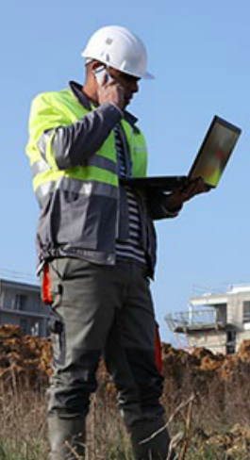
Troubleshooting Process Troubleshooting Process Steps
Introduction to Troubleshooting
Requires an organized and logical approach to problems.
Eliminates variables and identifies causes of problems in a systematic order.
Troubleshooting skills get better with experience.
Before troubleshooting, protect user data.
Identify the Problem
Ask the customer questions and be respectful.
Use both open-ended and closed-ended questions.
Listen to beep codes.
Use BIOS or UEFI to identify POST problems.
Use Event Viewer, Device Manager, Task Manager and other diagnostics tools to help identifying the problem.
Notes:
4.2 – Troubleshooting Process
4.2.1 – Troubleshooting Process Steps
BIOS (basic input/output system)
Unified Extensible Firmware Interface (UEFI)
Power-On Self-Test (POST)
Complementary metal–oxide–semiconductor, abbreviated as CMOS

Slide 18
Troubleshooting Process Troubleshooting Process Steps (Cont.)
Establish a Theory of Probable Cause
Create a list of the most common reasons for the error.
List the easiest or most obvious causes at the top and more complex causes at the bottom.
Research the symptoms.
Test the Theory to Determine Cause
Test your theories one at a time.
If none of the theories can be confirmed, create new ones.
Establish a Plan of Action to Resolve the Problem and Implement the Solution
Write down a plan to solve the identified problem.
May require simple or complex procedures.
Notes:
4.2 – Troubleshooting Process
4.2.1 – Troubleshooting Process Steps (Cont.)

Slide 19
Troubleshooting Process Troubleshooting Process Steps (Cont.)
Verify Full System Functionality and, if applicable, Implement Preventive Measures
The troubleshooting process is not over until full system functionality is confirmed.
If the system is working properly, implement preventive measures if needed.
Document Findings, Actions and Outcomes
Explain the problem to the customer, both verbally and in writing.
The customer should try to reproduce the problem after the solution has been implemented.
Document the entire process for future reference.
Notes:
4.2 – Troubleshooting Process
4.2.1 – Troubleshooting Process Steps (Cont.)

Slide 20
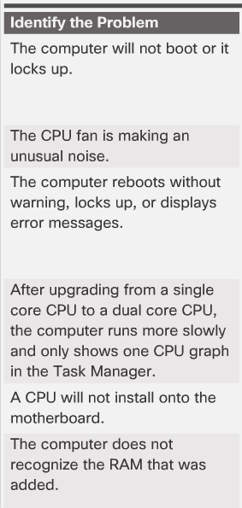
Troubleshooting Process Common Problems and Solutions
PC Common Problems and Solutions
Computer problems can be attributed to hardware, software, networks, or some combination of the three.
Common PC hardware problems include:
Storage device problems
Motherboard and internal components problems
Power supply problems
CPU and memory problems
Notes:
4.2 – Troubleshooting Process
4.2.2 – Common Problems and Solutions

Slide 21
4.3 Chapter Summary
Notes:
Cisco Networking Academy Program
IT Essentials
Chapter 4: Overview of Preventive Maintenance

Slide 22
Chapter Summary Summary
This chapter discussed the concepts of preventive maintenance and the troubleshooting process.
Regular preventive maintenance reduces hardware and software problems.
Before beginning any repair, back up the data on a computer.
The troubleshooting process is a guideline to help you solve computer problems in an efficient manner.
Document everything that you try, even if it fails. The documentation that you create is a useful resource for you and other technicians.
Notes:
4.3.1.1 - Summary

Slide 24


Slide 25
Chapter 4 New Terms and Commands
celsius
diagnostic
downtime
fahrenheit
overheating
overspinning
spyware
Notes:
New Terms and Commands

